Slide 1
Pneumatic Systems
For control and automation

Slide 2
Contents
At the end of this class, you will learn
Basic of pneumatic systems, Gas laws
Components of pneumatics systems
Symbols
Circuit layout
Sequential control
Actuator control 2/2 Valve
Sequence solution
5/3 Valves
Actuator control 3/2 Valve
Poppet/spool logic
Actuator control 5/2 Valve
Balanced spool logic

Slide 3
Introduction
This module will describe the basics of pneumatics and will show the methods of application of pneumatic valves and components for control and automation
The methods of pure pneumatic sequential control are confined to simple examples
The majority of modern systems are controlled electronically and is the subject of electro-pneumatic modules
A message to pneumatic circuit designers:
  Use proven and reliable design techniques
  Produce circuits and documentation that are clear to read
  Design for safety
  Do not try to be too clever, the circuit will be difficult for others to read and maintain

Slide 4
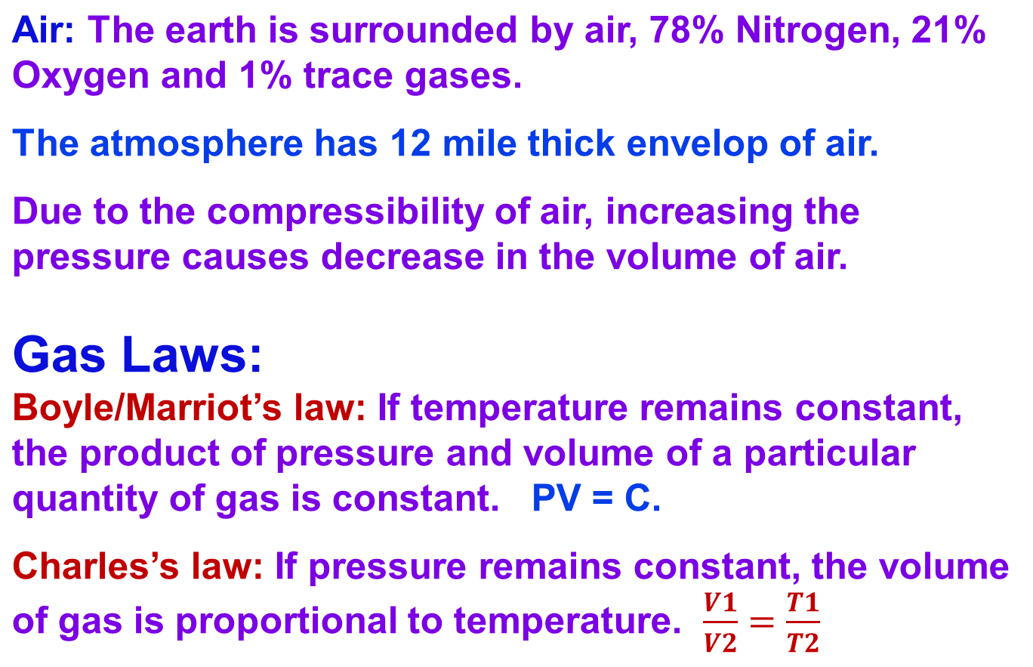
Basics of Pneumatics:

Slide 5
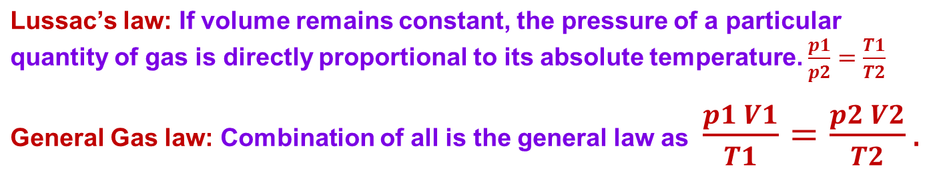
Gas Laws (contd.):
There are a few advantages if using compressed air as a source are:
Cleanliness
Pressure is transmitted undiminished in all direction throughout the system
Low cost
The best solution for the jig and fixture systems, automation lines, pick and place in electronics industry.
A disadvantage: Typical maximum pressure for a pneumatic system is 7 to 10 bars. This indicates that the pneumatic system are not suitable for the heavy duty in terms of load.

Slide 6
Bar: The bar is defined using the SI derived unit, pascal:
1 bar ≡ 100,000 Pa ≡ 100,000 N/m².
Thus, 1 bar is equal to:
1,000,000 Ba (barye) (in cgs units);
1 bar is approximately equal to:
0.987 atm
14.5038 psi absolute
29.53 inHg
750.06 mmHg
750.06 Torr
1019.72 centimetres of water (cmH₂O).

Slide 7
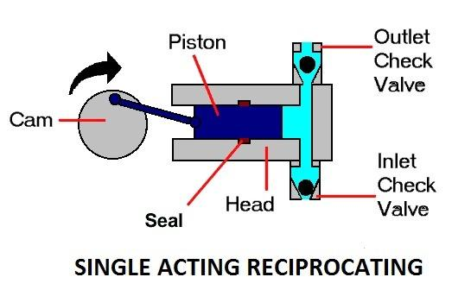
Compressors: It is a machine that compresses air or another type of gas from a low inlet pressure (usually atmosphere) to a higher desired pressure level. This is achieved by reducing the volume of the gas.
Air compressors are either reciprocating piston type of the rotary screw type.

Slide 8
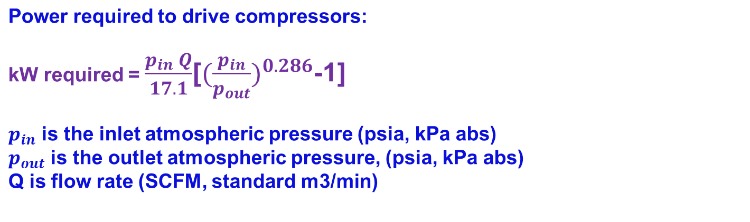
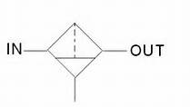
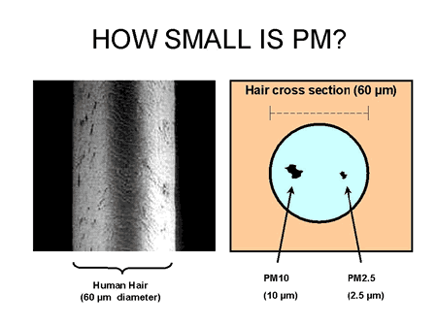
Air Filter:
The inlet air is filtered before it is used. The air needs to be free of moisture and contamination. The air filters are used to remove the contaminated particles as small as possible (5 microns and less)
Particulate matter, or PM, is the term for particles found in the air, including dust, dirt, soot, smoke, and liquid droplets. Particles can be suspended in the air for long periods of time. Some particles are large or dark enough to be seen as soot or smoke. Others are so small that individually they can only be detected with an electron microscope.

Slide 9
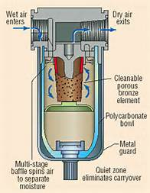
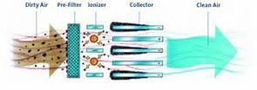
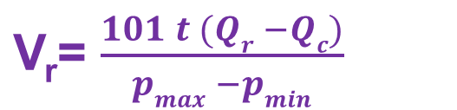
Operating principle of Air Filter
The size of a air reservoir is given by
Where, Vr = reservoir size,
t = times that the reservoir can supply required amount of air (min)
Qr = consumption rate of pneumatic system (m3/min)
Qc = output flow rate of compressor (m3/min)
Pmax = maximum pressure level in reservoir (kPa)
Pmin = minimum pressure level in reservoir (kPa)

Slide 10
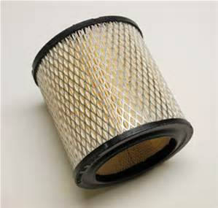
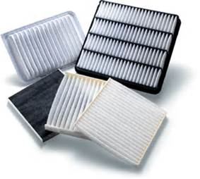
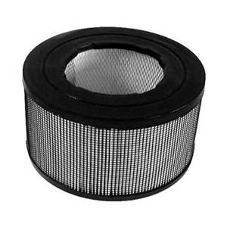
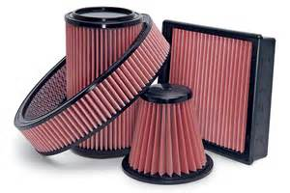
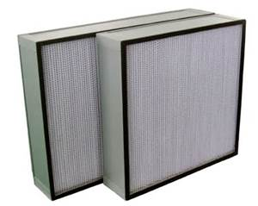
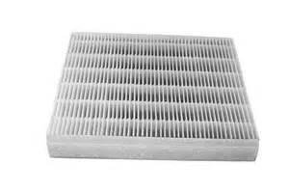
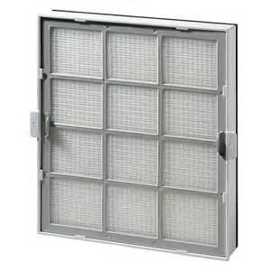
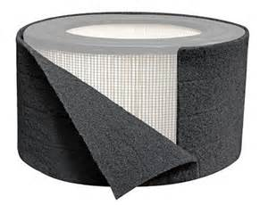
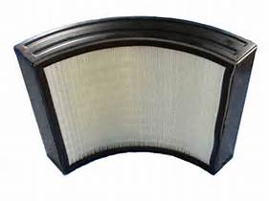
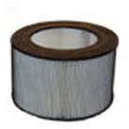
Some available air filters in the market

Slide 11
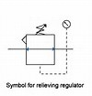
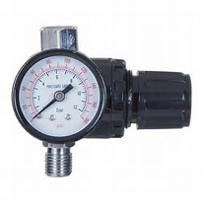
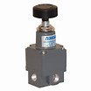

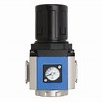


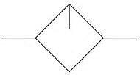
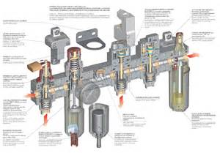

Air pressure regulator: The function is to adjust the pressure of the pneumatic system
Air Lubricator: The function is to ensure proper lubrication of the pneumatic system.
Air service unit: The function is to ensure preparation of optimum compressed air for a specific pneumatic system

Slide 12
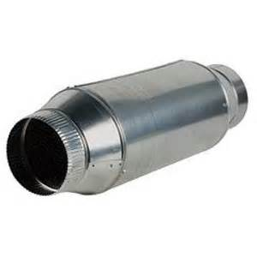
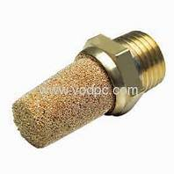
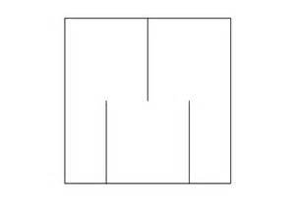
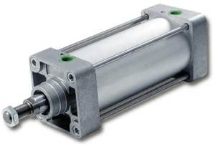
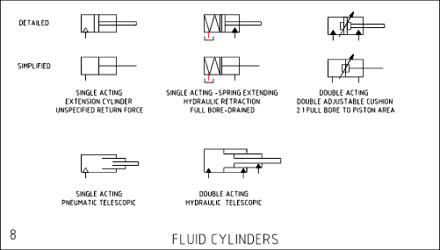
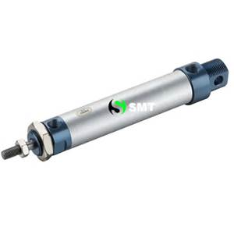
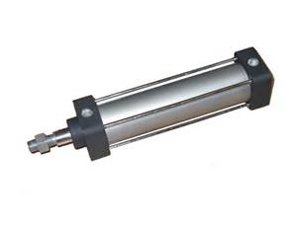
Pneumatic silencer: A silencer may be used to decrease the noise in the outlet of valves. Usually they are made from the porous plastic or bronze.
Pneumatic cylinder: The cylinders convert the energy of the compressed air into linear motion which extend or retract the piston rod.

Slide 13
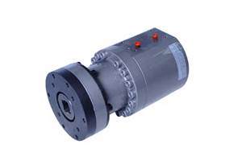
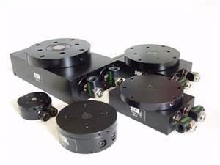
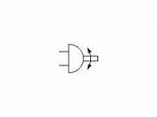
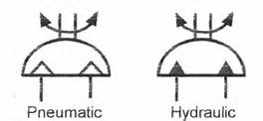
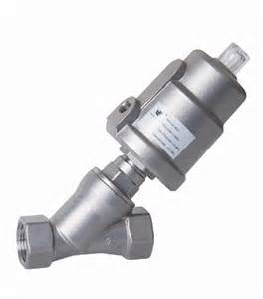
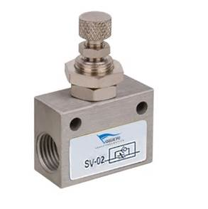
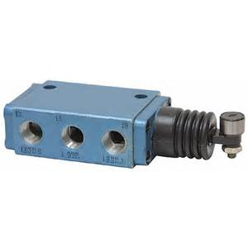
Pneumatic Rotary Actuator: The rotary actuators convert the energy of the compressed air into rotary motion. Most of them are Vane air motor.
Pneumatic Valves: The valves are used to control flow, pressure and direction of airflow.

Slide 14
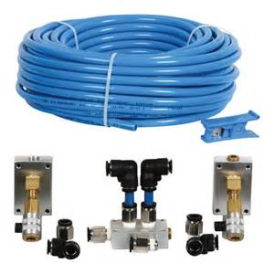
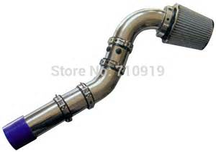
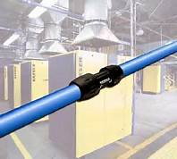
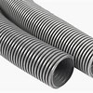
Pipes in pneumatic systems
Pipe materials and size: Air systems are normally plumbed with Schedule 40 black iron pipe. (Galvanized pipe is not recommended because some galvanizing material may flake off and get into moving parts.) Several other available plumbing materials could be used for air piping because pressure is relatively low. Some mechanics recommend plastic pipe, but be aware a few synthetic compressor lubricants attack plastic and cause it to lose strength. This type of damage weakens the plastic until it can burst, sending shards of plastic flying everywhere in the plant. Never use any piping material not specifically designated by code.

Slide 15
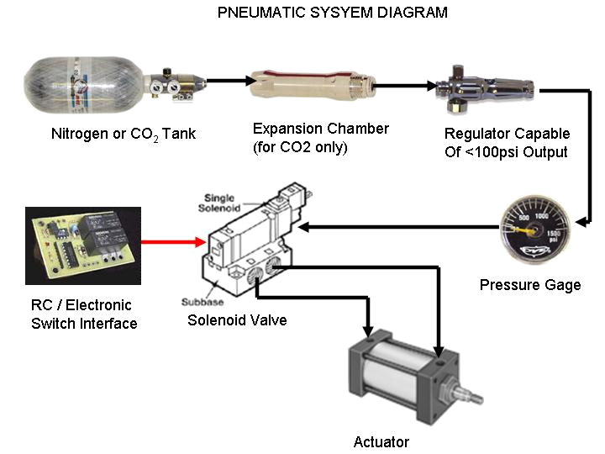
A Typical Pneumatic System

Slide 16
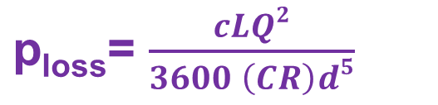
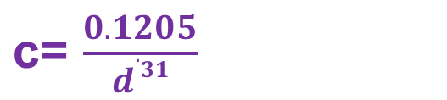
Actuating systems: Either it can be manual or solenoid based.
Air pressure losses in pipelines: Due to friction, while air flows through a pipe, it losses energy. The loss of energy shows up as a pressure loss, which can be calculated from Harris formula.
Where
p_{loss} = pressure loss (psi)
c = experimentally determined coefficient
L = length of pipe (ft)
Q = flow rate (SCFM)
CR = Compression ration , pressure in pipe/atmospheric pressure
d = inside diameter of pipe (in)
The coefficient c can be represented as a function of the inside diameter of the pipe as

Slide 17
Consideration of Pneumatic circuit design
The following four important considerations are taken into account while designing a pneumatic circuit:
Safety
Performance
Efficiency
Costs
Symbols for Pneumatic circuit design
The standard for fluid power symbols is ISO 1219-1. This is a set of basic shapes and rules for the construction of fluid power symbols
Cylinders can be drawn to show their extreme or intermediate positions of stroke and any length above their width
Valves show all states in the one symbol. The prevailing state is shown with the port connections
Other components are single state symbols

Slide 18
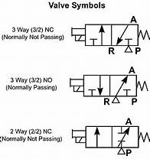
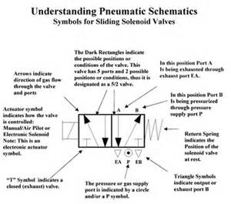
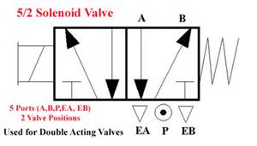
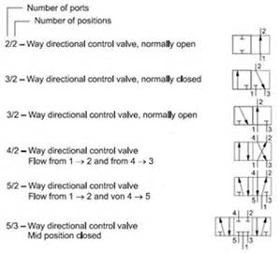

Symbols of pneumatic valve

Slide 19
Symbols single acting actuators
Single acting, sprung instroked
Single acting, sprung outstroked
Single acting, sprung instroked, magnetic
Single acting, sprung outstroked, magnetic
Symbols double acting actuators
Double acting, non-cushioned
Double acting, adjustable cushions
Double acting, through rod, adjustable cushions
Double acting, magnetic, adjustable cushions
Double acting, rodless, magnetic, adjustable cushions

Slide 20
Symbols rotary actuators
Semi-rotary double acting
Rotary motor single direction of rotation
Rotary motor bi-directional
Symbols valves
2/2 Valve push button / spring
3/2 Valve push button / spring
3/2 Valve lever operated
2
12
10
1
12
2
10
3
1
2
10
12
3
1

Slide 21
Symbols valves
A valve function is known by a pair of numbers e.g. 3/2. This indicates the valve has 3 main ports and 2 states
The valve symbol shows both of the states
Port numbering is to CETOP RP68P and shows:
  when the valve is operated at the 12 end port 1 is connected to port 2
  when reset to the normal state at the 10 end port 1 is connected to nothing (0); port 3 is connected to port 2.
2
12
10
3
1

Slide 22
Symbols valves
This example is for a 5/2 valve
This has 5 main ports and 2 states
When the valve is operated at the 14 end port 1 is connected to port 4 (also port 2 is connected to port 3)
When reset to the normal state at the 12 end port 1 is connected to port 2 (also port 4 is connected to port 5)
4
2
14
12
5
1
3

Slide 23
Symbols valves
This example is for a 5/2 valve
This has 5 main ports and 2 states
When the valve is operated at the 14 end port 1 is connected to port 4 (also port 2 is connected to port 3)
When reset to the normal state at the 12 end port 1 is connected to port 2 (also port 4 is connected to port 5)
4
2
14
12
5
1
3
Symbols 5/3 valves
All valves types shown in the normal position
Type 1. All ports blocked
Type 2. Outlets to exhaust
Type 3. Supply to outlets

Slide 24
Symbols valves
12
2
3/2 Valve differential pressure operated
5/2 Valve push button / spring
5/3 Valve double pressure operated spring centre
10
3
1
4
2
14
12
5
1
3
4
2
5
1
3

Slide 25
Symbols operators manual
General manual
Lever
Push button
Pedal
Pull button
Treadle
Push/pull button
Rotary knob
Notes:
27

Slide 26
Symbols operators mechanical
Plunger
Pressure
Spring normally as a return
Pilot pressure
Roller
Differential pressure
Uni-direction or one way trip
Detent in 3 positions
Notes:
27

Slide 27
Symbols function components
Non-return valve
Flow regulator uni-directional
Flow regulator bi-directional
Two pressure ‘AND’
Shuttle valve ‘OR’
Silencer
Quick exhaust valve with silencer
Pressure to electric switch adjustable
*
ISO 1219-1
Old
* Note: Traditional symbol in extensive use (preferred)

Slide 28
Symbols air line equipment
Water separator with automatic drain
Filter with manual drain
Filter with automatic drain
Filter with automatic drain and service indicator
Lubricator
Pressure regulator with gauge
F.R.L. filter, regulator, lubricator simplified symbol

Slide 29
Circuit layout
The standard for circuit diagrams is ISO 1219-2
A4 format or A3 folded to A4 height for inclusion in a manual with other A4 documentation
To be on several sheets if necessary with line identification code
Minimum crossing lines
Limit valves position of operation by actuators shown by a marker with reference code to symbol
Circuits should be drawn with all actuators at the top of the page in order of sequential operation
Other components to be drawn in sequential order from the bottom up and from left to right
Circuit should show the system with pressure applied and ready to start

Slide 30
Component identification
The ISO suggested component numbering system is suited for large circuits and those drawn on several pages
For this presentation a simple code is used
For cylinders: A,B,C etc.
For associated feedback valves: alpha-numeric code ‘a0’ for proof of instroke, ‘a1’ for proof of outstroke
For cylinder B: b0 and b1
Note: the a0 valve symbol is drawn in the operated position because the actuator A is instroked
a0
a1
A
12
2
12
2
10
10
a0
3
1
a1
3
1

Slide 31
Example circuit
a0
a1
b0
b1
c0
c1
A
B
C
Sequence
Run/End
A+
B+
B-
C+
C-
A-
Repeat
Run/End
a0
a1
b1
b0
c1
c0
10 bar max
6 bar
To all inlet ports marked

Slide 32
Actuator control 2/2 valve

Slide 33
2/2 Valve actuator control
A pair of the most basic of all valve types the 2/2 can be used to control a single acting cylinder
The normally closed position of the valve is produced by the spring
The operated position is produced by the push button
One valve admits air the other valve exhausts it
2
1
12
10
12
10
1
2
OUT
IN

Slide 34
2/2 Valve actuator control
The button marked OUT is pushed to operate the valve
Air is connected to the cylinder and it outstrokes
Air cannot escape to atmosphere through the valve marked IN as this is closed
The air at atmospheric pressure in the front of the cylinder vents through the breather port
2
1
12
10
12
10
1
2
OUT
IN

Slide 35
2/2 Valve actuator control
The push button of the valve marked OUT is released and it returns to a normal closed position
Air is now trapped in the system and provided there are no leaks the piston rod will stay in the outstroked position
If the load increases beyond the force exerted by the air the piston rod will start to move in
2
1
12
10
12
10
1
2
OUT
IN

Slide 36
2/2 Valve actuator control
The button marked IN is pushed to operate the valve
Air escapes and the piston rod moves to the instroked position
The push button must be held operated until the piston rod is fully in
Atmospheric air will be drawn in to the front of the cylinder through the vent port
2
1
12
10
12
10
1
2
OUT
IN

Slide 37
2/2 Valve actuator control
If the button marked IN is released the piston rod will remain in the instroked position
Any leaks in the installation can cause the piston rod to creep
2
1
12
10
12
10
1
2
OUT
IN

Slide 38
2/2 Valve actuator control
To control the speed of the piston rod, flow restrictors are placed in the pipes close to each of the valves.
Adjustment of the restrictors will slow down the flow rate thereby giving independent outstroke and instroke speed control
2
1
12
10
12
10
1
2
OUT
IN
Notes:
The flow regulators should be close to the push button valves. The reason for this is the pipework and valve cavity volume between the push button valves and their flow regulators act as small reservoirs. This will cause the movement to overrun after releasing each button.
If the flow regulators are placed the other side of the push button valves, the reservoir effect will cause a slight jump in the cylinder action when each button is first pushed.

Slide 39
2/2 Valve actuator control
By repeated operation of either button during movement the piston rod can be moved in small steps for approximate positioning
This will only be successful under slow speeds
2
1
12
10
12
10
1
2
OUT
IN

Slide 40
2/2 Valve actuator control
With any compressed air system that intentionally traps air, the potential hazard of this must be recognised
Unintended release or application of pressure can give rise to unexpected movement of the piston rod
A pressure indicator or gauge must be fitted to warn of the presence of pressure
2
1
12
10
12
10
1
2
OUT
IN

Slide 41
Actuator control 3/2 valve

Slide 42
3/2 valve actuator control
A 3 port valve provides the inlet and exhaust path and is the normal choice for the control of a single acting cylinder
In the normal position produced by the spring, the valve is closed
In the operated position produced by the push button the valve is open
The push button must be held down for as long as the cylinder is outstroked
12
2
10
3
1

Slide 43
3/2 valve actuator control
A 3 port valve provides the inlet and exhaust path and is the normal choice for the control of a single acting cylinder
In the normal position produced by the spring, the valve is closed
In the operated position produced by the push button the valve is open
The push button must be held down for as long as the cylinder is outstroked
12
2
10
3
1

Slide 44
3/2 valve actuator control
A 3 port valve provides the inlet and exhaust path and is the normal choice for the control of a single acting cylinder
In the normal position produced by the spring, the valve is closed
In the operated position produced by the push button the valve is open
The push button must be held down for as long as the cylinder is outstroked
12
2
10
3
1

Slide 45
3/2 valve actuator control
To generally slow the cylinder speed an adjustable
bi-directional flow regulator or fixed restrictor can be used
The flow regulator setting will be a compromise as the ideal outstroke speed may not produce the desired results for the instroke speed
12
2
10
3
1

Slide 46
3/2 valve actuator control
To control the outstroke speed of a single acting cylinder without controlling the instroke speed, a uni-directional flow regulator is used
The flow into the cylinder closes the non return valve and can only pass through the adjustable restrictor
By adjusting the restrictor the outstroke speed of the cylinder can be set
12
2
10
3
1

Slide 47
3/2 valve actuator control
For independent speed control in each direction two flow regulators are required
Installed in opposite directions to each other
Upper regulator controls the outstroke speed
Lower regulator controls the instroking speed
12
2
10
3
1

Slide 48
3/2 valve actuator control
A 3 port valve provides the inlet and exhaust path and is the normal choice for the control of a single acting cylinder
In the normal position produced by the spring, the valve is closed
In the operated position produced by the push button the valve is open
The push button must be held down for as long as the cylinder is outstroked
12
2
10
3
1

Slide 49
Actuator control 5/2 valve

Slide 50
5/2 Valve actuator control
-
+
For a double acting cylinder the power and exhaust paths are switched simultaneously
When the button is pushed the supply at port 1 is connected to port 4 and the outlet port 2 connected to exhaust port 3. The cylinder moves plus
When the button is released port 1 is connected to port 2 and port 4 connected to port 5. Cylinder minus
4
2
14
12
5
1
3

Slide 51
5/2 Valve actuator control
For a double acting cylinder the power and exhaust paths are switched simultaneously
When the button is pushed the supply at port 1 is connected to port 4 and the outlet port 2 connected to exhaust port 3. The cylinder moves plus
When the button is released port 1 is connected to port 2 and port 4 connected to port 5. Cylinder minus
-
+
4
2
14
12
5
1
3

Slide 52
5/2 Valve actuator control
Independent speed control of the plus and minus movements
In most applications speed is controlled by restricting air out of a cylinder
Full power is developed to drive the piston with speed controlled by restricting the back pressure
-
+
4
2
14
12
5
1
3

Slide 53
5/2 Valve actuator control
Independent speed control of the plus and minus movements
In most applications speed is controlled by restricting air out of a cylinder
Full power is developed to drive the piston with speed controlled by restricting the back pressure
-
+
4
2
14
12
5
1
3

Slide 54
5/2 Valve actuator control
Valves with a spring return are mono-stable and need the operator to be held all the time that the cylinder is required in the plus position
Bi-stable valves will stay in the position they were last set
The lever valve example illustrated indicates a detent mechanism. The lever need not be held once the new position has been established
-
+
4
2
14
12
5
1
3

Slide 55
Manual control
Remote manual control of a double acting cylinder
Valve marked + will cause the cylinder to outstroke or move plus
Valve marked - will cause the cylinder to instroke or move minus
The 5/2 double pilot valve is bi-stable therefore the push button valves only need to be pulsed
-
+
4
2
14
12
5
1
3
12
2
12
2
10
10
+
3
1
-
3
1

Slide 56
Manual control
Remote manual control of a double acting cylinder
Valve marked + will cause the cylinder to outstroke or move plus
Valve marked - will cause the cylinder to instroke or move minus
The 5/2 double pilot valve is bi-stable therefore the push button valves only need to be pulsed
-
+
4
2
14
12
5
1
3
12
2
12
2
10
10
+
3
1
-
3
1

Slide 57
Manual control
Remote manual control of a double acting cylinder
Valve marked + will cause the cylinder to outstroke or move plus
Valve marked - will cause the cylinder to instroke or move minus
The 5/2 double pilot valve is bi-stable therefore the push button valves only need to be pulsed
-
+
4
2
14
12
5
1
3
12
2
12
2
10
10
+
3
1
-
3
1

Slide 58
Manual control
Remote manual control of a double acting cylinder
Valve marked + will cause the cylinder to outstroke or move plus
Valve marked - will cause the cylinder to instroke or move minus
The 5/2 double pilot valve is bi-stable therefore the push button valves only need to be pulsed
-
+
4
2
14
12
5
1
3
12
2
12
2
10
10
+
3
1
-
3
1

Slide 59
Manual control
Remote manual control of a double acting cylinder
Valve marked + will cause the cylinder to outstroke or move plus
Valve marked - will cause the cylinder to instroke or move minus
The 5/2 double pilot valve is bi-stable therefore the push button valves only need to be pulsed
-
+
4
2
14
12
5
1
3
12
2
12
2
10
10
+
3
1
-
3
1

Slide 60
Semi-automatic control
Manual remote start of a double acting cylinder with automatic return
Cylinder identified as “A”
Trip valve operated at the completion of the plus stroke identified as “a1”
-
+
a1
A
4
2
14
12
5
1
3
12
2
12
2
10
10
+
3
1
-
a1
3
1

Slide 61
Fully-automatic control
-
+
a0
a1
Continuous automatic cycling from roller operated trip valves
Manual Run and End of the automatic cycling
Cylinder will come to rest in the instroked position regardless of when the valve is put to End
Tags for the roller feedback valves a0 and a1 show their relative positions
A
4
2
14
12
5
1
3
2
10
12
Run/End
3
1
12
2
12
2
10
10
a0
3
1
a1
3
1

Slide 62
Electro-pneumatic
Circuit building block for each cylinder
The majority of systems use electrical/electronic control due to the high degree of sophistication and flexibility
Solenoid valves are used to control cylinders
Feedback signals are from reed switches, sensors and electrical limit switches
Logic is hard wired or programmed in to a PLC (programmable logic controller)
a0
a1
A
4
2
14
12
5
1
3
a0
a1

Slide 63
5/3 Valve
5/3 valves have a third mid position
The valve can be tri-stable e.g. a detented lever operator or mono-stable e.g. a double air or double solenoid with spring centre
There are three common configurations for the mid position:
  All ports blocked
  Centre open exhaust
  Centre open pressure
The majority of applications are actuator positioning and safety
4
2
14
12
5
1
3
14
4
2
12
5
1
3
14
4
2
12
5
1
3

Slide 64
5/3 Valve actuator control
The valve illustrated has “all ports blocked” in the mid position
Whenever the mid position is selected the pressure conditions in the cylinder will be frozen
This can be used to stop the piston at part stroke in some positioning applications
Flow regulators mounted close to the cylinder to minimise creep
4
2
14
12
5
1
3

Slide 65
5/3 Valve actuator control
The valve illustrated has “all ports blocked” in the mid position
Whenever the mid position is selected the pressure conditions in the cylinder will be frozen
This can be used to stop the piston at part stroke in some positioning applications
Flow regulators mounted close to the cylinder to minimise creep
4
2
14
12
5
1
3

Slide 66
5/3 Valve actuator control
The valve illustrated has “all ports blocked” in the mid position
Whenever the mid position is selected the pressure conditions in the cylinder will be frozen
This can be used to stop the piston at part stroke in some positioning applications
Flow regulators mounted close to the cylinder to minimise creep
4
2
14
12
5
1
3

Slide 67
5/3 Valve actuator control
The valve illustrated has “all ports blocked” in the mid position
Whenever the mid position is selected the pressure conditions in the cylinder will be frozen
This can be used to stop the piston at part stroke in some positioning applications
Flow regulators mounted close to the cylinder to minimise creep
4
2
14
12
5
1
3

Slide 68
5/3 Valve actuator control
The valve illustrated has “all ports blocked” in the mid position
Whenever the mid position is selected the pressure conditions in the cylinder will be frozen
This can be used to stop the piston at part stroke in some positioning applications
Flow regulators mounted close to the cylinder to minimise creep
4
2
14
12
5
1
3

Slide 69
5/3 Valve actuator control
This version of a 5/3 valve is “centre open exhaust”
The supply at port 1 is isolated and the cylinder has power exhausted when this centre position is selected
The version illustrated shows a mono-stable version double pilot operated spring centre
The cylinder will be pre-exhausted when changing from the mid position
14
4
2
12
5
1
3

Slide 70
5/3 Valve actuator control
This version of a 5/3 valve is “centre open pressure”
The supply at port 1 is connected to both sides of the cylinder and the exhaust ports isolated when this centre position is selected
Can be used to balance pressures in positioning applications
The version illustrated is mono-stable, double solenoid, spring centre
14
4
2
12
5
1
3

Slide 71
Logic functions for valves

Slide 72
Logic AND
Z
To obtain the output Z both plungers X AND Y must be operated and held
If X only is operated the air will be blocked at port 1 in valve Y
If Y only is operated there will be no pressure available at port 1
If either X or Y is released the output signal Z will be lost
2
12
10
Y
3
1
2
12
10
X
3
1

Slide 73
Logic AND
Z
To obtain the output Z both plungers X AND Y must be operated and held
If X only is operated the air will be blocked at port 1 in valve Y
If Y only is operated there will be no pressure available at port 1
If either X or Y is released the output signal Z will be lost
2
12
10
Y
3
1
2
12
10
X
3
1

Slide 74
Logic AND
Z
To obtain the output Z both plungers X AND Y must be operated and held
If X only is operated the air will be blocked at port 1 in valve Y
If Y only is operated there will be no pressure available at port 1
If either X or Y is released the output signal Z will be lost
2
12
10
Y
3
1
2
12
10
X
3
1

Slide 75
Logic AND
Z
To obtain the output Z both plungers X AND Y must be operated and held
If X only is operated the air will be blocked at port 1 in valve Y
If Y only is operated there will be no pressure available at port 1
If either X or Y is released the output signal Z will be lost
2
12
10
Y
3
1
2
12
10
X
3
1

Slide 76
Logic AND
To obtain the output Z both plungers X AND Y must be operated and held
If X only is operated the air will be blocked at port 1 in valve Y
If Y only is operated there will be no pressure available at port 1
If either X or Y is released the output signal Z will be lost
Z
2
12
10
Y
3
1
2
12
10
X
3
1

Slide 77
Logic AND
Z
To obtain the output Z both plungers X AND Y must be operated and held
If X only is operated the air will be blocked at port 1 in valve Y
If Y only is operated there will be no pressure available at port 1
If either X or Y is released the output signal Z will be lost
2
12
10
Y
3
1
2
12
10
X
3
1

Slide 78
Logic AND
Z
To obtain the output Z both plungers X AND Y must be operated and held
If X only is operated the air will be blocked at port 1 in valve Y
If Y only is operated there will be no pressure available at port 1
If either X or Y is released the output signal Z will be lost
2
12
10
Y
3
1
2
12
10
X
3
1

Slide 79
Logic AND
Z
This method must not be used as a two handed safety control
It is too easy to abuse. e.g. one of the buttons could be permanently fixed down and the system operated from the other button only
Use the purpose designed two handed safety control unit
2
12
10
Y
3
1
2
12
10
X
3
1

Slide 80
Logic OR
Z
Use of an ‘OR’ function shuttle valve
Source X and Y can be remote from each other and remote from the destination of Z
When X or Y is operated the shuttle valve seal moves across to prevent the signal Z from being lost through the exhaust of the other valve
2
12
10
Y
3
1
2
12
10
X
3
1

Slide 81
Logic OR
Z
Use of an ‘OR’ function shuttle valve
Source X and Y can be remote from each other and remote from the destination of Z
When X or Y is operated the shuttle valve seal moves across to prevent the signal Z from being lost through the exhaust of the other valve
2
12
10
Y
3
1
2
12
10
X
3
1

Slide 82
Logic OR
Z
Use of an ‘OR’ function shuttle valve
Source X and Y can be remote from each other and remote from the destination of Z
When X or Y is operated the shuttle valve seal moves across to prevent the signal Z from being lost through the exhaust of the other valve
2
12
10
Y
3
1
2
12
10
X
3
1

Slide 83
Logic OR
Z
Use of an ‘OR’ function shuttle valve
Source X and Y can be remote from each other and remote from the destination of Z
When X or Y is operated the shuttle valve seal moves across to prevent the signal Z from being lost through the exhaust of the other valve
2
12
10
Y
3
1
2
12
10
X
3
1

Slide 84
Logic OR
Z
Use of an ‘OR’ function shuttle valve
Source X and Y can be remote from each other and remote from the destination of Z
When X or Y is operated the shuttle valve seal moves across to prevent the signal Z from being lost through the exhaust of the other valve
2
12
10
Y
3
1
2
12
10
X
3
1

Slide 85
Logic NOT
A logic NOT applies to the state of the output when the operating signal is present (the output is simply an inversion of the operating signal)
The valve shown is a normally open type (inlet port numbered 1)
When the signal X is present there is NOT output Z
When X is removed output Z is given
Z
2
12
10
X
1
3

Slide 86
Logic NOT
A logic NOT applies to the state of the output when the operating signal is present (the output is simply an inversion of the operating signal)
The valve shown is a normally open type (inlet port numbered 1)
When the signal X is present there is NOT output Z
When X is removed output Z is given
Z
2
12
10
X
1
3

Slide 87
Logic NOT
A logic NOT applies to the state of the output when the operating signal is present (the output is simply an inversion of the operating signal)
The valve shown is a normally open type (inlet port numbered 1)
When the signal X is present there is NOT output Z
When X is removed output Z is given
Z
2
12
10
X
1
3

Slide 88
3/2 NO / NC
2
A fully balanced valve allows pressure on any pot or combination of ports
A single valve can be used normally open or normally closed
For normally open the supply pressure is connected to port 1
For normally closed the supply pressure is connected to port 3
12
10
3
1
2
12
10
3
1

Slide 89
3/2 NO / NC
2
12
10
A fully balanced valve allows pressure on any pot or combination of ports
A single valve can be used normally open or normally closed
For normally open the supply pressure is connected to port 1
For normally closed the supply pressure is connected to port 3
3
1
2
12
10
3
1

Slide 90
3/2 Valve selection / diversion
Selection of one of two supplies connected to ports 1 and 3 can be different pressures
Diversion of one supply to one of two outlets
If it is required to exhaust the downstream air a 5/2 valve is required
2
12
10
3
1
3
1
12
10
2

Slide 91
3/2 Valve selection / diversion
2
Selection of one of two supplies connected to ports 1 and 3 can be different pressures
Diversion of one supply to one of two outlets
If it is required to exhaust the downstream air a 5/2 valve is required
12
10
3
1
3
1
12
10
2

Slide 92
Latch with controls
In this version of a latch the push button valves are connected to perform ‘OR’ and ‘NOT’ functions
The ‘OFF’ valve must be placed last in the signal chain so that if both valves are operated together the ‘OFF’ command will dominate over the ‘ON’ command
Out
2
12
10
3
1
ON
2
12
10
3
1
OFF
2
12
10
3
1

Slide 93
OR, AND, NOT
z
OR
2
12
10
A single 3/2 pilot operated spring return valve can be use for any of these logic functions
x OR y gives output z
x AND y gives output z
x gives NOT z
3
1
x
y
z
AND
2
12
10
3
1
x
y
z
NOT
2
12
10
3
1
x

Slide 94
Single pulse maker
z
Converts a prolonged signal x into a single pulse z
Signal z must be removed to allow the valve to reset then x can be applied again
The duration of the pulse can be adjusted with the flow regulator
2
12
10
3
1
x

Slide 95
Slow initial pressure build up
Choose a 3/2 pilot spring valve with a relatively high operating force e.g. 3 to 4 bar
When the quick connect coupling is made, the output at port 2 is controlled at the rate of the flow regulator setting
When the pressure is high enough to operate the valve full flow will take over
2
12
10
3
1

Slide 96
End

